Slide 1
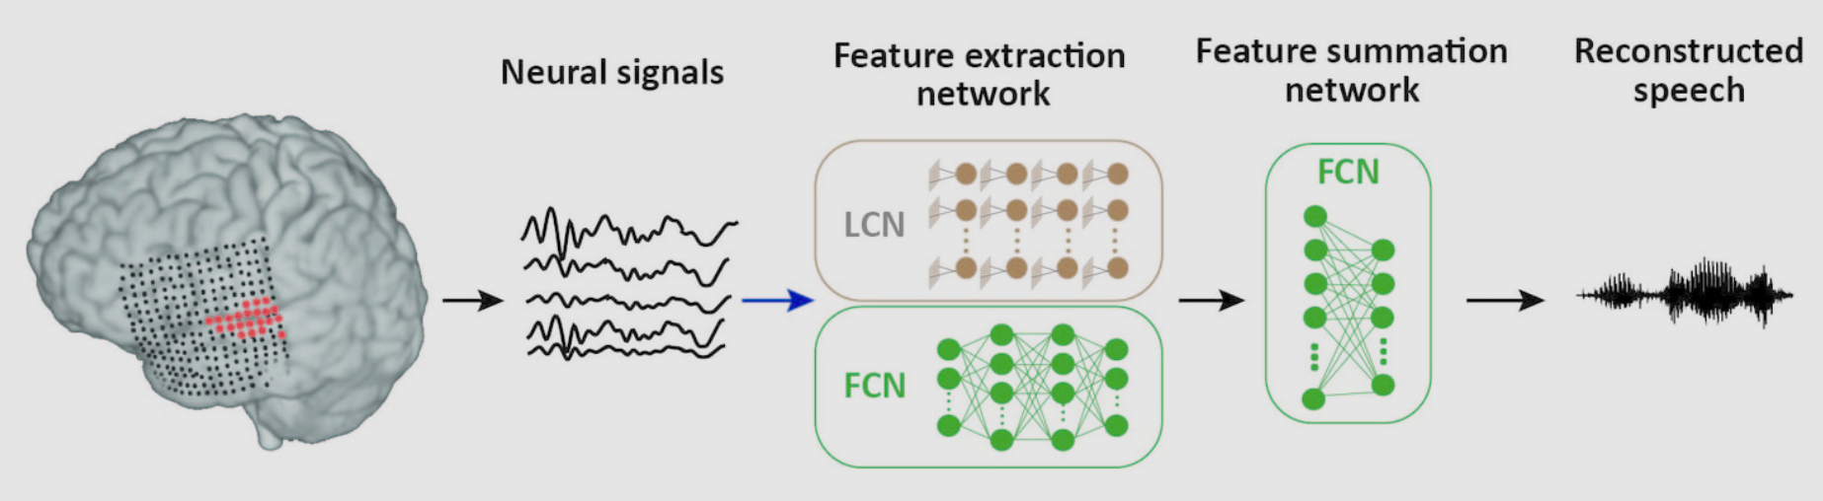
Engager: Brain waves to speech!!
Training data: 30 minutes of continuous speech stories spoken by two male and two female speakers.
​Test data: Digits zero to nine spoken by two male and two female speakers. The digits and the speakers who uttered them were not included in the training data.
http://naplab.ee.columbia.edu/reconstruction.html

Slide 2
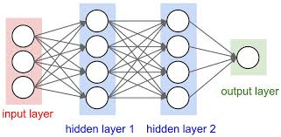
Neural networks… are graphs!

Slide 3
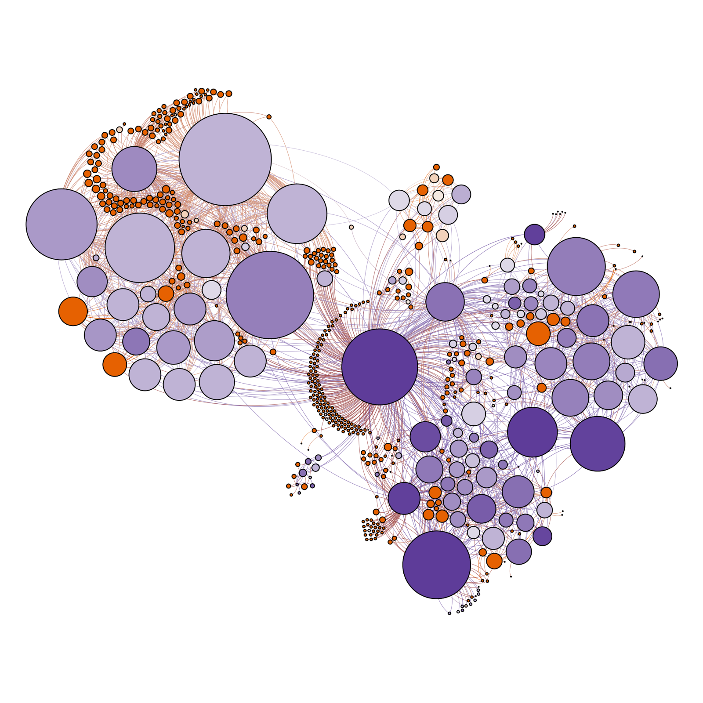
Graphs
the abstract data type of the immediate future

Slide 4
Vertices/nodes and edges
This is a vertex…
It is also a node…
Nodes and vertices are the same thing.

Slide 5
Vertices and edges
Here are two vertices with an edge joining them

Slide 6
Vertex Characteristics
We can describe a vertex by how many edges are connected to it. We call this the degree of the vertex.
degree 1 degree 2 degree 3 degree 4

Slide 7
Graphs
A graph is any collection of vertices and edges

Slide 8
Connected Graphs
A connected graph is one where it is possible to travel from one vertex to any other by traversing one or more edges

Slide 9
Connected Graphs
This is NOT a connected graph
?
?
?

Slide 10
Directed Graphs
A directed graph features edges that only go in one direction

Slide 11
Weighted Graphs
A weighted graph assigns values to it’s edges (like the distance between two vertices, the strength of the connection, etc.)
42

Slide 12
Labelled Graphs
A labelled graph contains labels on each vertex.
A
B

Slide 13
Circuits
A graph contains a circuit if there is more than one path that connects two vertices
no circuit a circuit

Slide 14
Trees
A tree is a graph that does not contain any circuits and is connected.

Slide 15
Forest
Is a collection of trees (how cute!)

Slide 16

Special Trees
You can join two trees together by adding just one edge to construct a bigger tree.
Seems obvious but it might be a useful thing to remember in a few lessons’ time.

Slide 17
Width of a graph
The width of a graph is the minimum distance required to ensure that it is possible to travel from any node to any other node.
It is the maximum of all of the minimum distances separating all pairs of nodes in a graph.

Slide 18
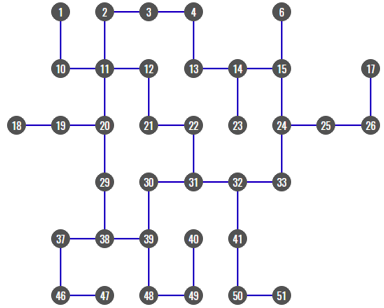
It is the maximum of all of the minimum distances separating all pairs of nodes in a graph.

Slide 19
It is the maximum of all of the minimum distances separating all pairs of nodes in a graph.

Slide 20
It is the maximum of all of the minimum distances separating all pairs of nodes in a graph.

Slide 21
It is the maximum of all of the minimum distances separating all pairs of nodes in a graph.

Slide 22
It is the maximum of all of the minimum distances separating all pairs of nodes in a graph.

Slide 23
It is the maximum of all of the minimum distances separating all pairs of nodes in a graph.

Slide 24
It is the maximum of all of the minimum distances separating all pairs of nodes in a graph.

Slide 25
It is the maximum of all of the minimum distances separating all pairs of nodes in a graph.

Slide 26
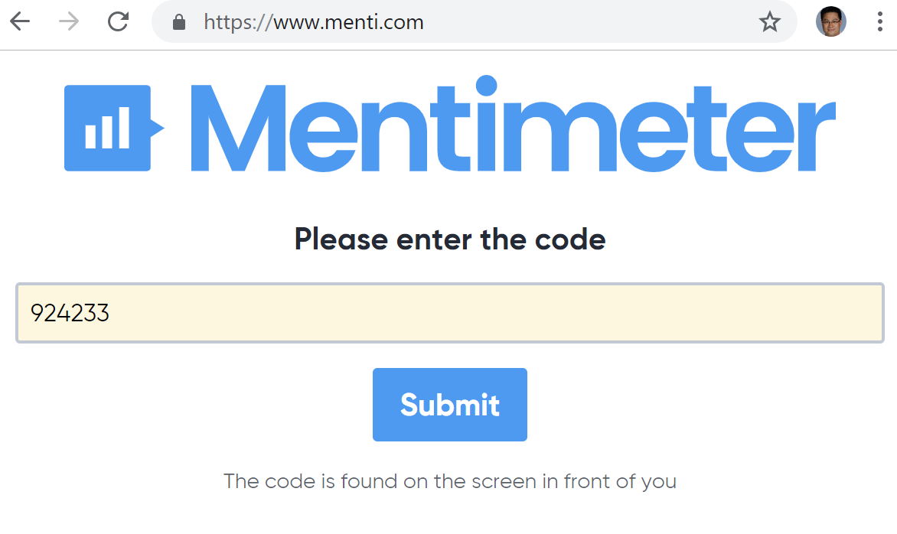

Slide 27
It is the maximum of all of the minimum distances separating all pairs of nodes in a graph.
What is the width of this graph?
TizH

Slide 28
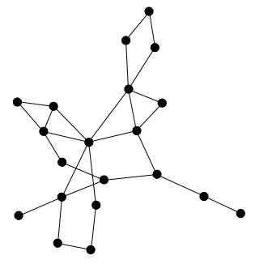
Width of a graph
If a graph has no weightings on its edges, the width simply refers to the number of edges that you have to traverse for the maximum-minimum separation of nodes.

Slide 29
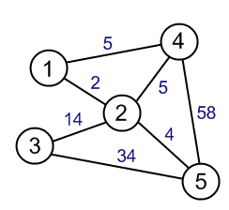
Width of a graph
If a graph has weightings on its edges, the width is then the addition of these weights that lead to the maximum-minimum separation of nodes.

Slide 30
Width of a graph
If a graph has weightings on it’s edges, the width is then the addition of these weights that lead to the maximum-minimum separation of nodes.
What is the width of this graph?

Slide 31
Minimal Spanning Trees
A minimal spanning tree represents the tree which will connect all nodes of the graph in the shortest possible distance

Slide 32
Minimal Spanning Trees
A minimal spanning tree represents the tree which will connect all nodes of the graph in the shortest possible distance

Slide 33
Minimal Spanning Trees
A minimal spanning tree represents the tree which will connect all nodes of the graph in the shortest possible distance
OR

Slide 34
Menti task: Describe this neural network using the terms you learned today

Slide 35
Input and Construction:
Let’s take a look at your solutions to the Missionaries and Cannibals problem...

Slide 36
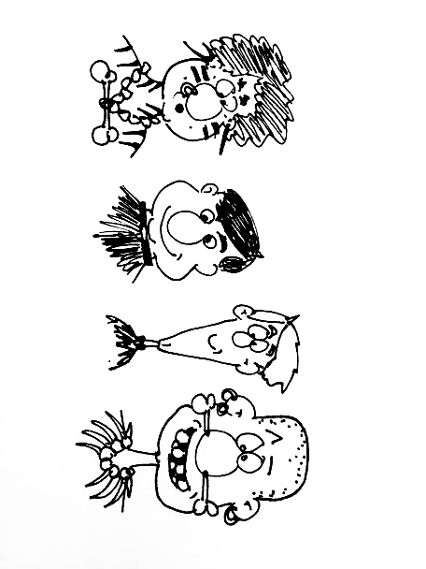
Input and Construction:
ADT’s are simply ways of representing information.
What is nice about ADT’s is that you are taking a real problem and representing it in an abstract way that focuses on what parts are necessary to the solution or representation. This is called Abstraction.

Slide 37
Input and Construction:
Once a model is represented by a particular ADT, we can then use the characteristics of that ADT to help solve it without even needing to know the original context of the problem.
Modelling data in the form of an ADT is an important first step in trying to solve the problem.
If a problem can be solved by repeatedly doing the same operation, we can reuse algorithms that solve these components repeatedly as part of a larger algorithm. This is known as Modularisation.

Slide 38
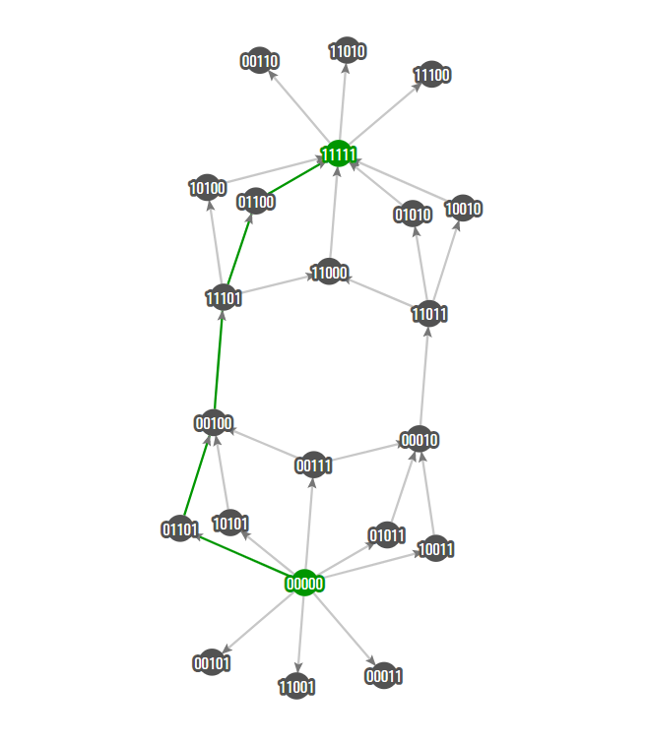

Slide 39
00000
Missionary 1, Missionary 2, Cannibal 1, Cannibal 2, Boat

Slide 40
00000
Missionary 1, Missionary 2, Cannibal 1, Cannibal 2, Boat

Slide 41
00000
Missionary 1, Missionary 2, Cannibal 1, Cannibal 2, Boat

Slide 42
00000
Missionary 1, Missionary 2, Cannibal 1, Cannibal 2, Boat

Slide 43
00000
Missionary 1, Missionary 2, Cannibal 1, Cannibal 2, Boat

Slide 44
00000
Missionary 1, Missionary 2, Cannibal 1, Cannibal 2, Boat

Slide 45
00000
For each of those digit positions:
0: means on the left side of the river
1: means on the right side of the river

Slide 46

00000

Slide 47
00000

Slide 48
11111

Slide 49
11111

Slide 50
00111

Slide 51
01010

Slide 52
10101

Slide 53
Pseudo-Code time!
Starting with:
Draw the rest of the graph showing only nodes with valid positions (ie. where the cannibals don’t eat the missionaries)
00000

Slide 54
Pseudo-Code time!
MMCCB
0 = Left
1 = Right
00000
00111
01011
00010
11011
10010
11111

Slide 55
Pseudo-Code time! - Another Representation
Boat Left Shore Right Shore
L MMCC ----
R MM-- --CC
L MMC- ---C
R --C- MM-C
L M-C- -M-C
R ---- MMCC
Boat Left Shore Right Shore
L MMCC ----
R M-C- M--C
L MMC- ---C
R --C- MM-C
L M-C- -M-C
R ---- MMCC

Slide 56
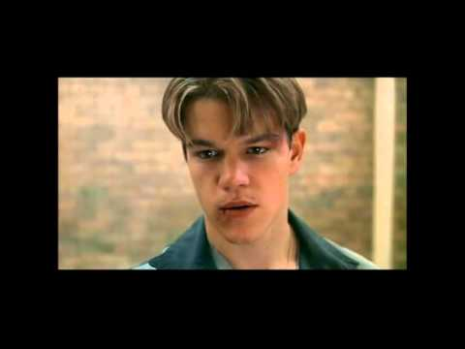
Good Will Hunting

Slide 57
Find all homeomorphically irreducible trees of degree ten

Slide 58
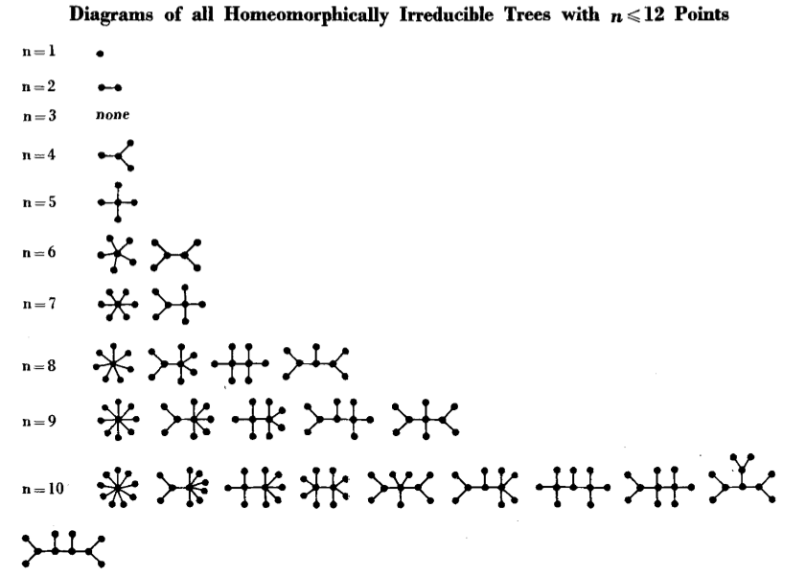
Find all homeomorphically irreducible trees of degree ten

